Slide 1
The Use of Generative AI to generate estimates for the project plan, design document, source code, test plan and test cases, user API documentation.
Group 17
Soham Kamble (A20517098)
Bhavya Chawla (A20516957)

Slide 2
Content:
Project Overview
Functional, Non Functional Requirements
Tools
Data Sets

Slide 3
Project Overview
What is Generative AI?
Generative AI refers to a cutting-edge technology that can create content, such as text or code, using machine learning algorithms. It has the potential to revolutionize the estimation process in project management.
Benefits of using generative AI for estimates:
Generative AI streamlines the estimation process by automating repetitive tasks, reducing human bias, and improving accuracy, ultimately leading to more reliable project plans and documents.
Challenges of using generative AI for estimates:
Despite its advantages, using generative AI for estimates presents challenges like data quality, model training, and ethical concerns.

Slide 4
Functional and Non Functional Requirements
Functional | Non Functional
Task-Specific Estimation | Accuracy of Estimates: The AI system's project plan and cost estimates should be accurate.
Customization | Cost Control: The project should stay within budget.
Real-time Estimation | Response Time: The AI system should respond within seconds
Data Integration | Scalability: The AI system should handle varying workloads.
Validation and Verification | Data Security: The AI system should ensure data security and privacy.
Notes:
Task-Specific Estimation:
Generating estimates for specific tasks and documents type, not just the effort but it estimates other Time for Coding (Hrs) for example
Scalability: The system works all workloads and we are able to train and test it for more projects, and also for more complex projects
Real-time Estimation The system provides -real-time estimates almost instantaneously
Accuracy of Estimates: The AI system's project plan and cost estimates should be accurate.
Customization: Users must be able to configure the generative AI model for different project domains
Real-time Estimation The system should provide near-real-time estimates to support agile project management
Data Integration: Should have the ability to seamlessly integrate and analyze project data from various sources.
Validation and Verification: There must be mechanisms in place to validate and verify the accuracy and reliability of the estimates generated by the AI model.
Non functional
Accuracy of Estimates: The AI system's project plan and cost estimates should be accurate.
Cost Control: The project should stay within budget.
Response Time: The AI system should respond within seconds
Scalability: The AI system should handle varying workloads.
Data Security: The AI system should ensure data security and privacy.

Slide 5







Tools

Slide 6
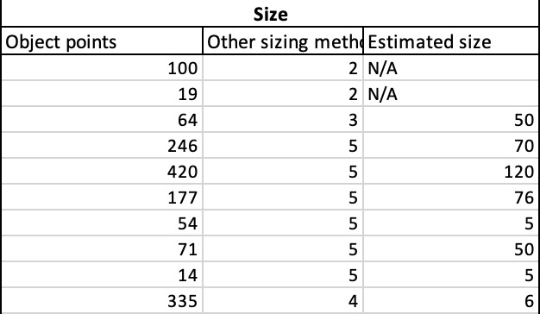
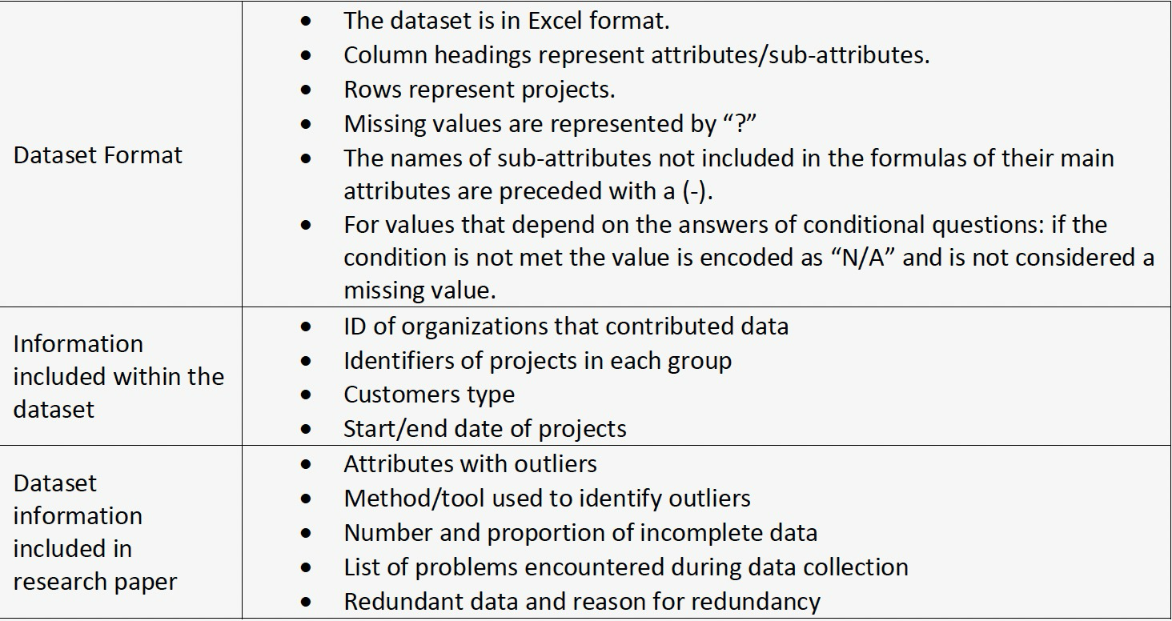
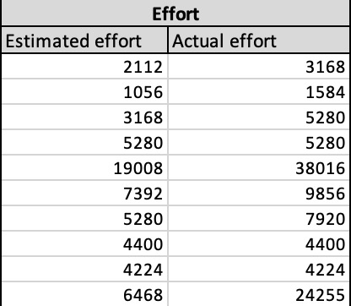
Data Set
The SEERA Software Cost Estimation Dataset - https://zenodo.org/records/3987969
It is the result of the collection of 120 software development project data from 42 organizations and dataset contains 76 attributes
The years taken in consideration for the data 1993 to 2019
Total of actual efforts 1087311.5 person hours
Total of estimated efforts 627022 person hours

Slide 7
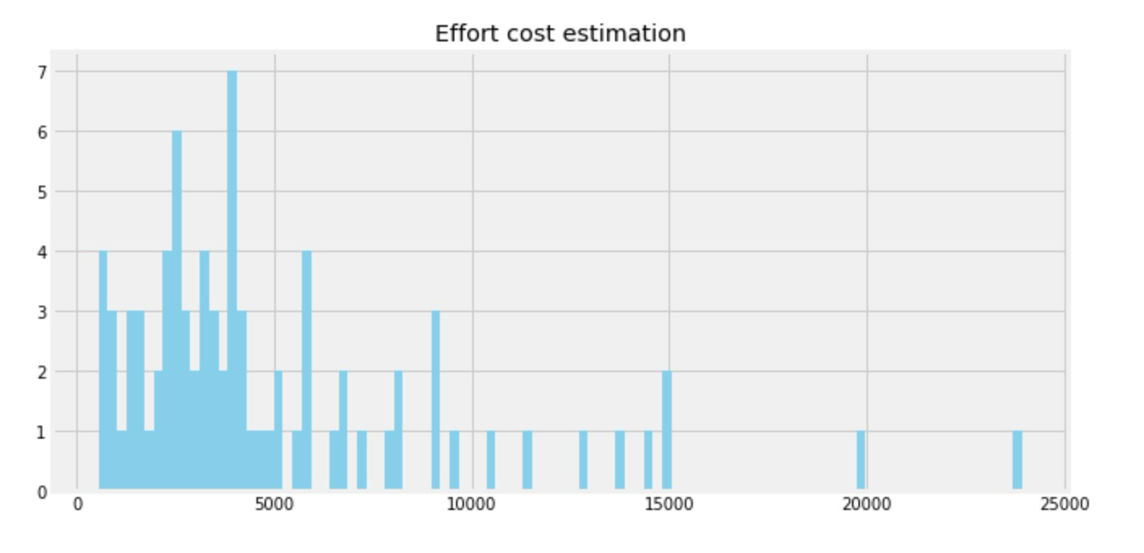
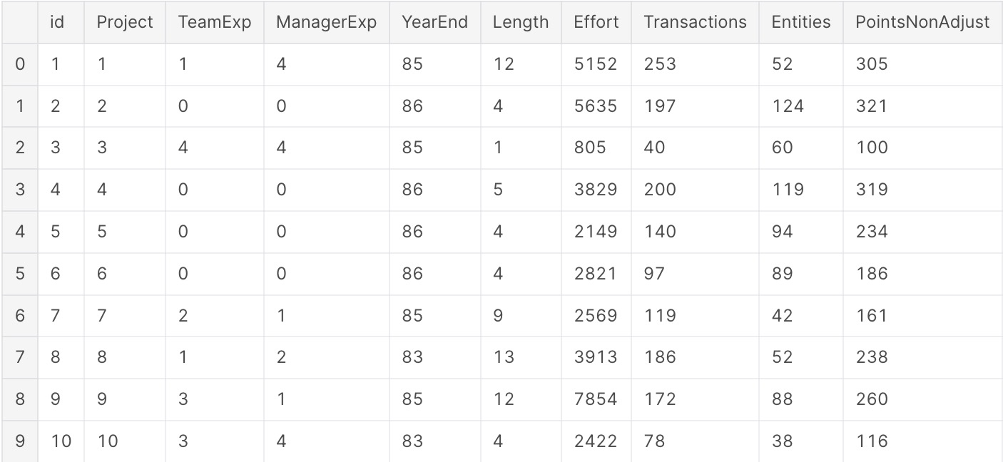
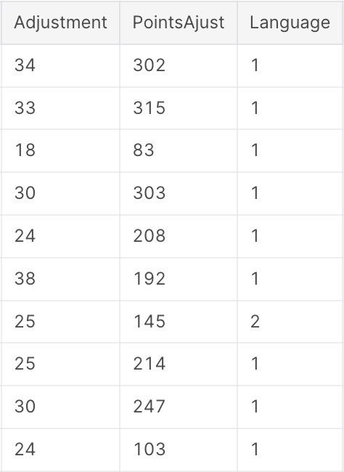
Data Set
Software Cost estimation - https://www.kaggle.com/code/raulvilla/sofware-cost-estimation-i
It is the result of the collection of 81 software development project
The years taken in consideration for the data 1982 to 1988
Total of actual efforts 408751 person hours
19

Slide 8
Data Set - others
PROMISE Software Engineering Repository - http://promise.site.uottawa.ca/SERepository/index.html
A collection of publicly available datasets and tools to serve researchers in building predictive software models (PSMs)
International Software Benchmarking Standards Group - https://www.isbsg.org/
GitHub
Kaggle Datasets

Slide 9
Project Timeline
Week 1: Project Initiation, Data Collection & Setup - Completed
Week 2: Model Training, Document Generation & Preliminary Review - In Progress
Week 3: Review Corrections, Finalization & Reporting
Notes:
Modify it accordingly

Slide 10
Thank you
https://platform.openai.com/docs/guides/gpt
https://www.nvidia.com/en-us/glossary/data-science/generative-ai/
https://www.linkedin.com/pulse/how-generative-ai-can-help-you-improve-employee-support-documentation#:~:text=API%20Documentation,for%20developers%20and%20the%20community.

